Slide 1

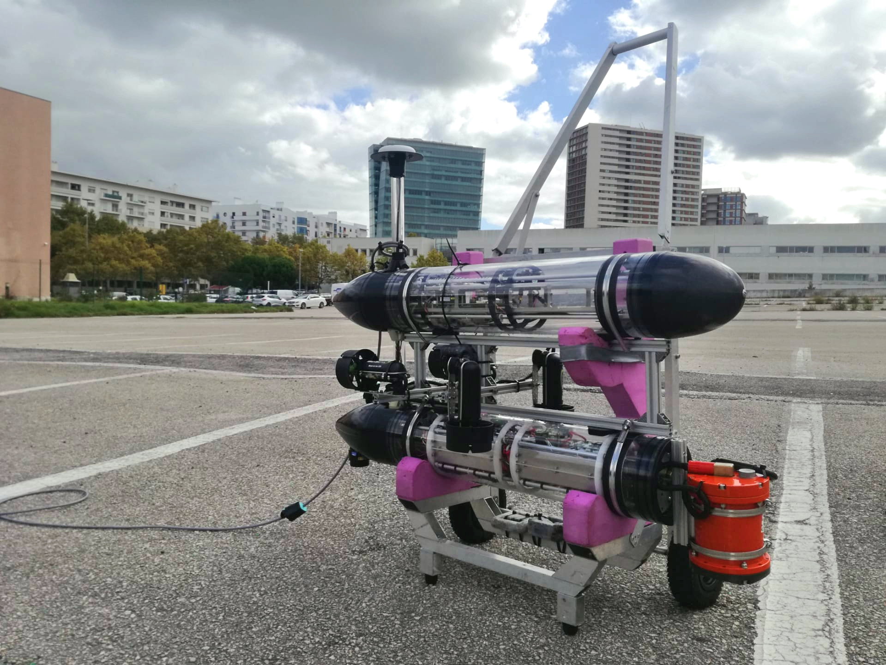
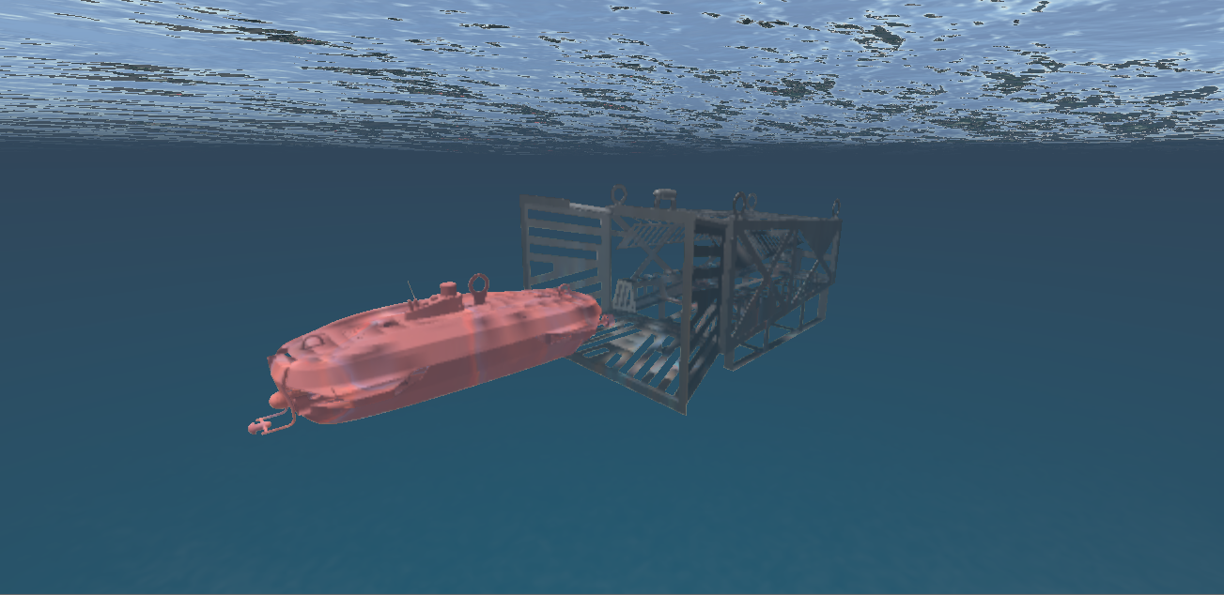
OCEANTECH
HROV Docking
Jan 10, 2021

Slide 2
Set up
HROV equipped with USBL that measures the
position of the Docking Station (DS) with respect to it
DS equipped with USBL that measures the
position of the HROV with respect to it
HROV equipped with Doppler log and AHRS
Goal
Dock HROV onto DS
N
N
E
HROV
N
Position of DS wrt HROV in
Inertial frame
-directed from DS to HROV
Docking Station
Lisbon, Jan 10, 2021

Slide 3
N
N
E
HROV
N
Docking Station

Slide 4
Problem 1
Find the orientation of the Docking Station with respect to the HROV, as captured by the rotation matrix

Slide 5
N
N
PROBLEM 1
E
Measurements:
HROV
(USBL on DStation, USBL on HROV)
N
Docking Station
- Rotation matrix from DS to HROV

Slide 6
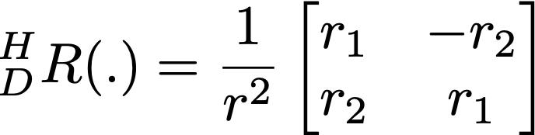
PROBLEM 1

Slide 7
Problem 2
How we detect the situation where the x-axes of the vehicles are parallel and point in opposite directions?

Slide 8
N
N
PROBLEM 2
Parallel, opposite directions
N
Docking Station
E
HROV
remember
N
In this situation
Docking Station
Or, equivalently,
USBL coordinates identical!

Slide 9
Problem 3
How we detect the situation where the x-axes of the vehicles are ALIGNED and point in opposite directions?

Slide 10
N
PROBLEM 3
Aligned, opposite directions
USBL coordinates identical AND
Y components are 0!
N
Docking Station
E
N
HROV

Slide 11
Problem 4
Find a simple strategy to maneuver the HROV in such a way as to align itself with the DS (x axis aligned, but in opposite directions)

Slide 12
PROBLEM 4
HROV maneuvering
N
N
E
HROV
STEP I
HROV rotates in place until
*
Notice that
*
where r is the rate of turn of HROV
Control Law to drive
to 0:
N
STEP II
HOLD HEADING and
Activate PURE SWAY motion
Docking Station

Slide 13
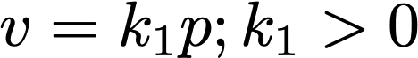
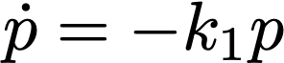
PROBLEM 4
STEP II
HOLD HEADING and
Activate PURE SWAY motion
(i.e., u=0)
How can this be done?
1. Read off initial heading of HROV
2. Implement a controller for yaw
“keeping” at the initial value.
3. Implement a body-axis
controller for (u,v) to keep u= 0 and make
where
p is obtained from the y
component of the HROV USBL reading
(u ,v) is obtained from the Doppler log
on board the HROV
N
HROV
p
E
0
N
Docking Station
HROV and DS
aligned in opposite
directions

Slide 14
Problem 5
Once problem 4 has been solved, move the HROV forward to DOCK onto DS

Slide 15
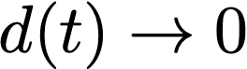
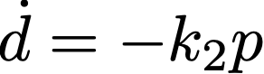
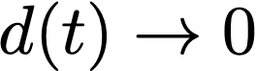
PROBLEM 5
STEP III
HOLD HEADING and
Activate PURE SURGE motion
(i.e., v=0)
(while activating sway control as in Step II of
Problem 4 to compensante
for small deviations from alignment)
Implement a body-axis
controller for (u,v) to keep v= 0 and make
where
d is obtained from the x
component of the HROV USBL reading
(u ,v) is obtained from the Doppler log
on board the HROV
N
E
d
0
N
Docking Station
Voilá!

Slide 16
Problem 6
Can we do the above in the presence of a constant unknown current?

Slide 17
6.1 Stop The HROV in the presence of a current, with a desired heading (no requirement about the stopping point)
N
DRIFTING
ROTATION
E
HROV
COUNTERACTING the CURRENT
- Velocity of the current in the inertial frame
- Velocity of HROV with respect to the fluid, in inertial frame
Objective: make = -
HROV stopped, with velocity with respect to the fluid symmetric with respect to the velocity of the fluid itself

Slide 18
Fighting the Current
- Total inertial HROV velocity
Drive to 0 by manipulating . Use the control law:
Stable system with
Control law in body axis /references for inner loops):

Slide 19
6.2 Now start the maneuver to make the two main axis of the HROV and DS parallel (see Problem 2 above, in the absence of currents)
N
DRIFTING
ROTATION
E
HROV
COUNTERACTING the CURRENT
*
Engage the systems to
keep the HROV stationary
and make its main axis parallel to that of the DS
HROV stopped, with velocity with respect to the fluid symmetric with respect to the velocity of the fluid itself

Slide 20
N
* Illustration of the operation
E
HROV
N
*
Docking Station

Slide 21
6.3 Manuever to align the axis of the HROV and DS, with opposite directions
N
(more complicated, because we need to move the vehicle and at the same time keep the objective of (asymptotically) driving the vehicle to a stop, counteracting the current).
E
Things to do at the same time:
(1) Engage the systems needed to keep the HROV and DS axis parallel
(2) Engage the system responsible for driving the y-component of the HROV USBL measurement to zero
(3) Fight the current
HROV
N
Docking Station
Detailed before
2), 3) – to be done now

Slide 22
Items 2) and 3)
Driving p (obtained from the y
component of the HROV USBL reading) to 0;
this is the only type of motion required at this point
(previously we used v (sway), but because we have currents we now declare that the total inertial velocity
Is the one that must be manipulated)
k_{T}
-
How do we make track
by manipulating ?
Velocity of HROV with respect to the
fluid, in inertial frame!
Stabe system with
Reference for inner loops!

Slide 23
6.4 – Drive the system towards the Docking Station
The strategy is “obvious” ☺

Slide 24
N
LOS Path Following
(to be detailed, adding a reference for
total HROV speed that goes to 0 as
HROV gets closer to DS)
Do computations in D
Reference frame
N
E
HROV
Path to be followed
N
Docking Station
Now compute the angle of rotation of

